Slide 1


PY EXPO
Scientific Calculator
PROJECT TITTLE:
18
TEAM NUMBER:
Sairam K - B.Tech…,AI&DS
Rohith Vaasan A M - B.Tech…,AI&DS
Sabareeshwaran S - B.Tech…,AI&DS
TEAM MEMBERS:

Slide 2
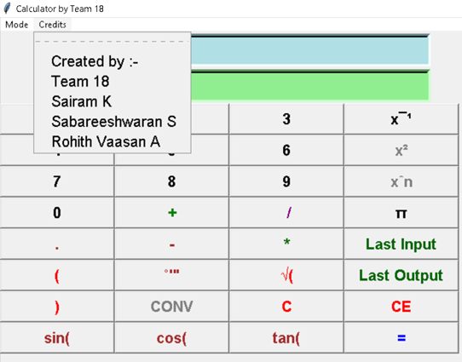
Problem Statement: Scientific calculator using python and with tkinter as graphical user interface.

Slide 3

About Tkinter
- A GUI

Slide 4

What is Graphical User Interface?

Slide 5
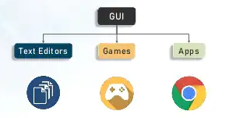
What is GUI?
GUI is a desktop app which helps to intract with computers.

Slide 6


Why we need GUI?
COMMAND LINE
GRAPHICAL USER INTERFACE
The Graphical User Interface is a type of user interface that allows users to interact with electronic devices through graphical iconic and visual indicators.

Slide 7
What Is Tkinter?

Slide 8
TKINTER
Out of all the GUI methods, tkinter is the most commonly used method. It is a standard Python interface .
Python with tkinter is the fastest and easiest way to create the GUI applications. Creating a GUI using tkinter is an easy task.
Tkinter is quite basic, and doesn't use native widgets. This means that Tkinter applications will look the same on any platform
Our project has been developed using tkinter to maintain a easy and efficient graphical interface.

Slide 9
Scientific calculator using Tkinter

Slide 10
SCIENTIFIC CALCULATOR
FEATURES:
Basic functions and exponents. Calculate basic functions such as addition, subtraction, multiplication, and division.
Exponential functions.
Trigonometric function.
Scientific notation.
Binary functions.
Unit Conversion.

Slide 11
Basic notations of our model in usage of python
Usage of arithmetic functions such as Addition , Subtraction etc.,
Usage Ariel font for displaying the keys
Specified the width and height of the keys for alignment
Provided a Convert button for converting operations
Used Background colours for little attractions
Provided the Credit option in the menu bar
Provided simple Trigonometric functions
GUI has been created using the help of tkinter

Slide 12
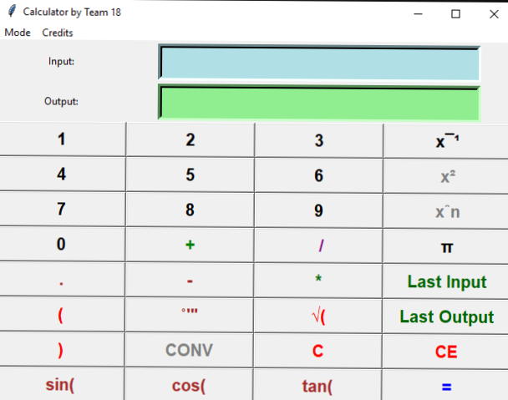
GUI MODULE
GUI MODULE is used for creating the general interface for the calculator model.

Slide 13
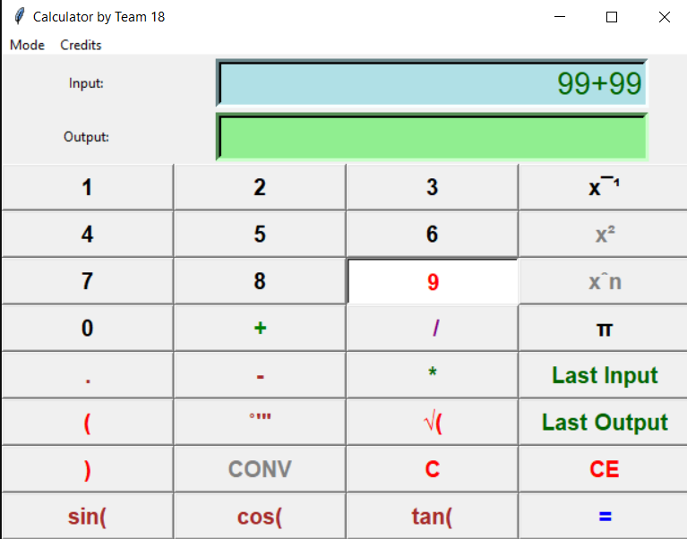
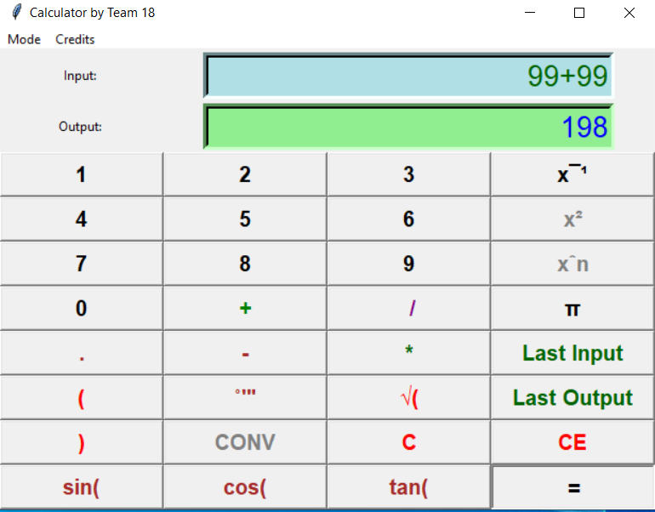
ARITHMETIC MODULE
This Arithmetic Module is used to handle the arithmetic problems.(Example: Addition, Subtraction, Multiplication, etc.)
ARITHMETIC

Slide 14
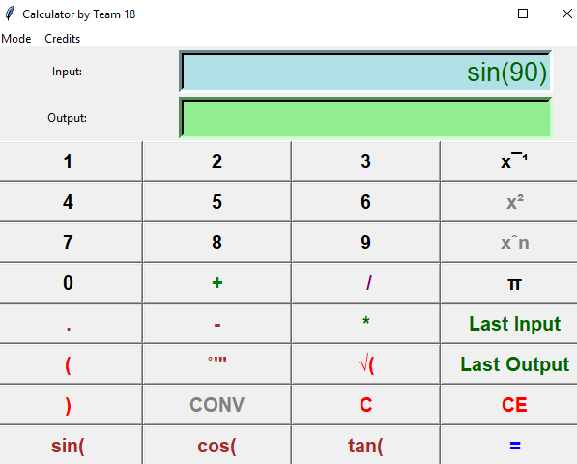
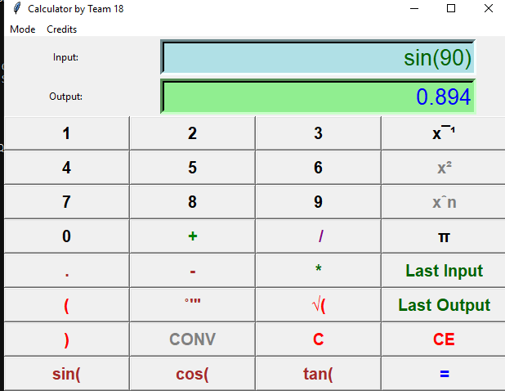
TRIGONOMETRIC MODULE
This Module is used for solving Trigonometric Functions.(Examples: sine ,cosine , etc.)
Output:
IN RADIANS

Slide 15
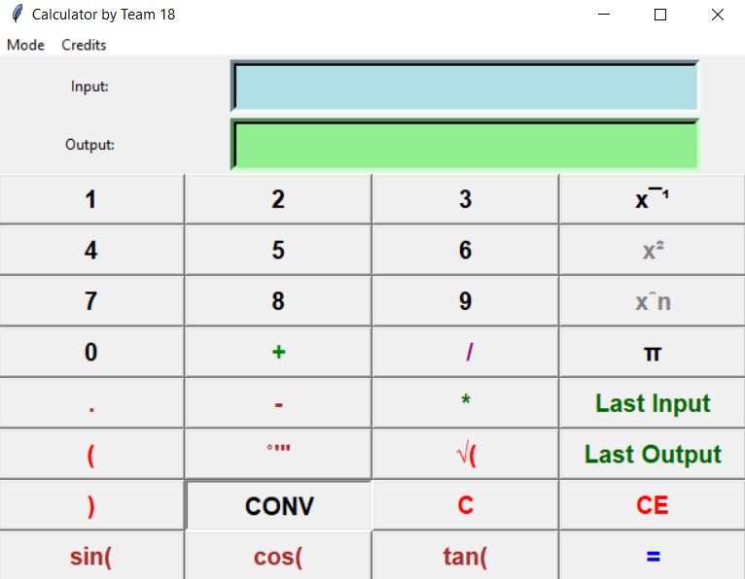
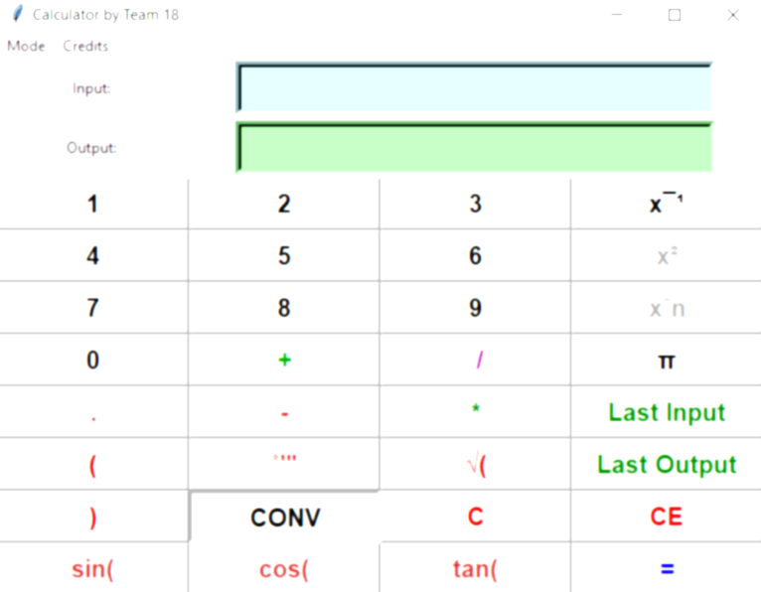
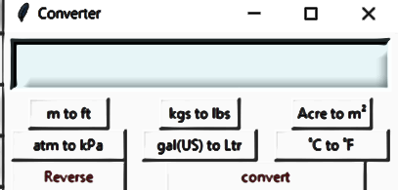
CONVERTING MODULE
This Module is used for convert any values to the desired format .
Example(meter to feet)
Converting options

Slide 16
Thank you!!!!
thanks for your patience…….
Wish us GOOD LUCK!.

Slide 17
Credits
1st year students:
Sairam K - B.Tech…,AI&DS
Rohith Vaasan A M - B.Tech…,AI&DS
Sabareeshwaran S - B.Tech…,AI&DS

